Slide 1
Data Mining: Introduction
Lecture Notes for Chapter 3
Standardized Sample Distribution

Slide 2
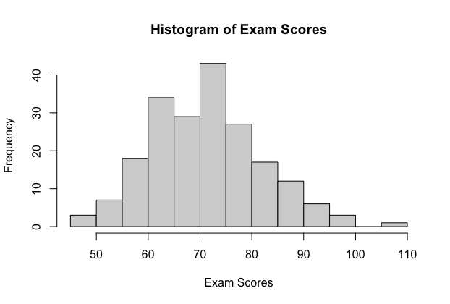

Sampling Distributions
Which could be the most reliable indicator of your exam performance?
When you received a score of 90 out of 100.
When the rank is 80.
When you achieved above than 90% of students.

Slide 3
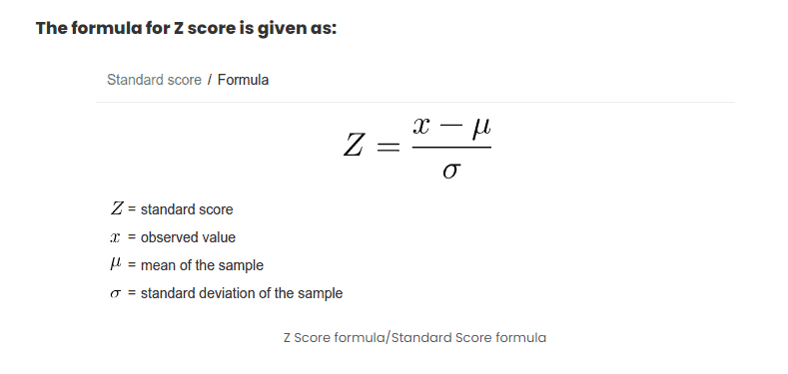
Z Score

Slide 4
Probability and Normal Distributions
Example:
The average on a statistics test was 78 with a standard deviation of 8. If the test scores are normally distributed, find the probability that a student receives a test score less than 90.
μ = 78
σ = 8
P(x < 90)
x
μ =78
90
z
μ =0
?
1.5

Slide 5
Empirical Rule (68-95-99.7%)
Standardized Normal distribution with µ = 0 and SD = 1
99.7% within 3 standard deviations
95% within 2 standard deviations
68% within 1 standard deviation
34%
34%
2.35%
2.35%
13.5%
13.5%
–4
–3
–2
–1
0
1
2
3
4

Slide 6
Probability and Normal Distributions
μ = 78
σ = 8
P(x < 90)
x
The probability that a student receives a test score less than 90 is 0.9332.
μ =78
90
z
μ =0
?
1.5
P(x < 90) = P(z < 1.5) = 0.9332

Slide 7
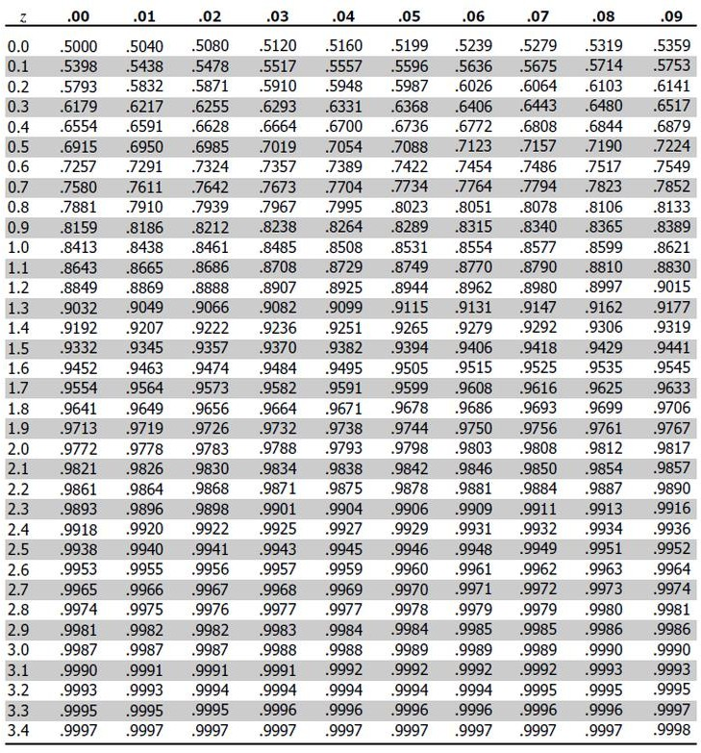
Standardized Sample Distribution – Z Distribution Table

Slide 8
Data Mining: Introduction
Hypothesis Testing

Slide 9
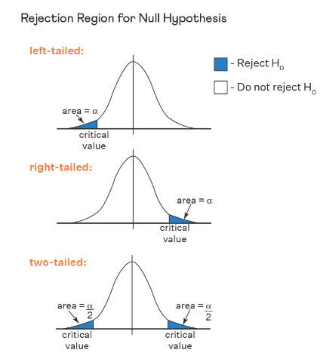
Hypothesis Testing - Process
Defining Hypotheses
  Null hypothesis (H0).
  Alternative hypothesis (H1)
Defining Level of significance.
Determine the test statistic and associated P-value.
Drawing a Conclusion

Slide 10
Hypothesis Testing – Null & Alternative Hypothesis
Null Hypothesis
The null hypothesis is a general statement or default position that there is no relationship between two measured cases or no relationship among groups. In other words, it is a basic assumption or made based on the problem knowledge. A company’s mean production is 50 units/per da H0: μ = 50.
In research studies, a researcher is usually interested in disproving the null hypothesis
Alternative Hypothesis
The alternative hypothesis is the hypothesis used in hypothesis testing that is contrary to the null hypothesis.
Example: A company’s production is not equal to 50 units/per day i.e. H1: μ ≠= 50.
The alternative hypothesis can be one- sided (only provides one direction, e.g., lower) or two-sided
10

Slide 11
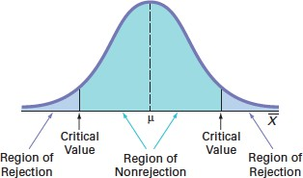
Hypothesis Testing – Significance Level
It refers to the degree of significance in which we accept or reject the null hypothesis. 100% accuracy is not possible for accepting a hypothesis.
Therefore, select a level of significance that is usually 5%. This is normally denoted with α
α is 0.05 or 5%, which means your output should be 95% confident to give a similar kind of result in each sample.
11

Slide 12

Hypothesis Testing – P-Value
The P value, or calculated probability, is the probability of finding the observed/extreme results when the null hypothesis(H0) of a study-given problem is true.
12
11/2/2024

Slide 13
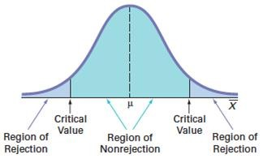
Hypothesis Testing – Outcomes and Conclusions
If p-value less than or equal to the significance level, the null hypothesis is rejected in favor of the alternative hypothesis
  The result is statistically significant
If the p-value is greater than or equal to the significance level, the null hypothesis is not rejected
  The result is not statistically significant
Accept Null
Hypothesis
Reject Null Hypothesis
13
11/2/2024

Slide 14
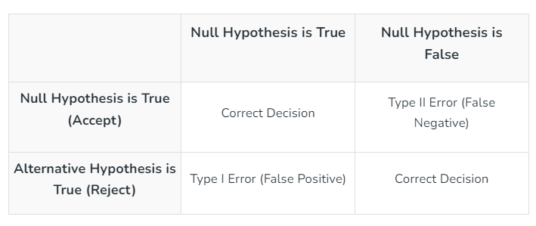
Hypothesis Testing – Type I and Type II Errors
14
11/2/2024

Slide 15
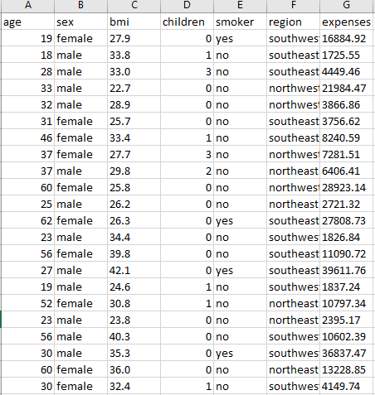
Hypothesis Testing – Example
Case A: Expenses on insurance are known to be on average 13K USD. You hypothesize that they are large. You collect the data in the csv file "insurance.csv".
15
11/2/2024

Slide 16
Hypothesis Testing – Example
Step 1: Define the Hypothesis
Null Hypothesis: (H₀) Average insurance expenses is 13000 USD
Alternate Hypothesis: (H₁) Average insurance expenses is larger than 13000 USD
Step 2: Define the Significance level
Let’s consider the Significance level at 0.05, indicating rejection of the null hypothesis.
16
11/2/2024

Slide 17
Hypothesis Testing – Example
Step 3: Compute the test statistic
The test statistic is calculated by using the z formula Z=(13270.42–13000)/(12110÷36.578)​ and we get accordingly , Z=0.81681.
Step 4: Find the p-value
p-value = 0.207
17
11/2/2024

Slide 18
Hypothesis Testing – Example
Step 5: Result
If the p-value is less than or equal to 0.05, the researchers reject the null hypothesis.
If the p-value is greater than 0.05, they fail to reject the null hypothesis.
Conclusion: Since the p-value (p-value = 0.207) is Larger than the significance level (0.05), the researchers fail to reject the null hypothesis.
18
11/2/2024

